Slide 1
Computer Vision
Viraat Das
Purdue Hackers Workshop

Slide 2
wus good
https://colab.research.google.com
https://github.com/viraatdas?tab=repositories
Files: http://bit.ly/2X4nLdv

Slide 3
Speed Prediction
Training video: video of driving containing 20400 frames. Video is shot at 20 fps
Each frame is 480 x 640
Training labels: speed of the car at each frame, one speed on each line.
Test video: different driving video containing 10798 frames. Video is shot at 20 fps.

Slide 4
What exactly is speed?
Is it possible to determine speed based on a single frame?
What about two? Three?
Optical flow
https://en.wikipedia.org/wiki/Optical_flow
https://opencv-python-tutroals.readthedocs.io/en/latest/py_tutorials/py_video/py_lucas_kanade/py_lucas_kanade.html
We’ll be using the Farneback (Dense optical flow) method.

Slide 5
What are we training?
Shuffle frame pairs
Validation – training split will be 90 – 10
We need two frames to determine the rate of change in frames

Slide 6
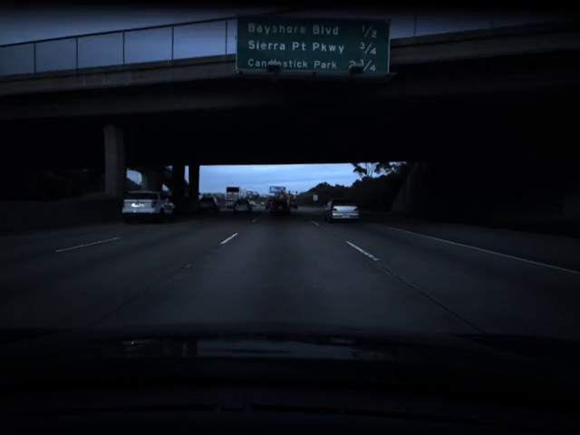

Preprocessing frames
This is an example of the kind of crop we’ll use
We’ll also adjust brightness.

Slide 7
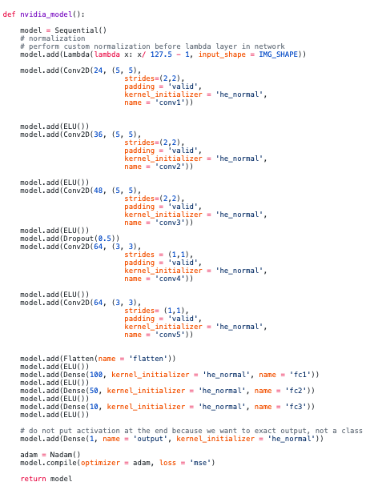
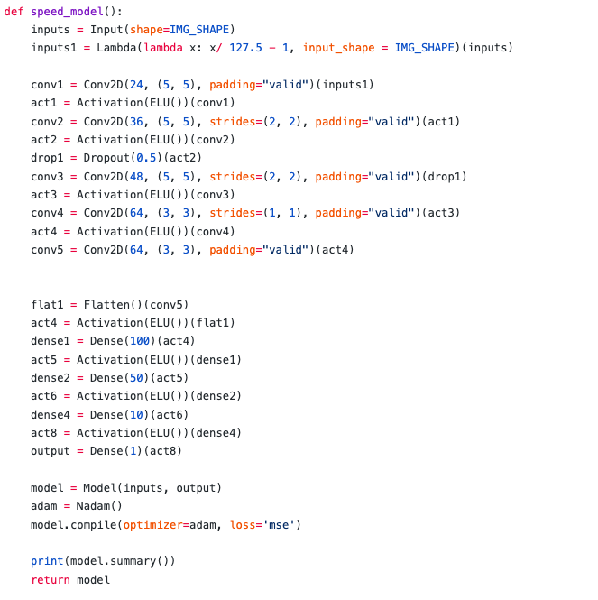
How are we training? Model architecture
NVIDIA model
https://images.nvidia.com/content/tegra/automotive/images/2016/solutions/pdf/end-to-end-dl-using-px.pdf

Slide 8
Crash course on CNNs
Relatively little pre-processing compared to other image classification algorithm
Typically the activation function used is RELU, but we’ll be using ELU.
Terminologies
Max pooling: sample based discretization process. Essentially allows for dimensionality reduction
Activation function: defines the output of the node given a set of inputs
ELU activation function: Exponential Linear Unit

Slide 9
Simplified Version of what we’ll be training
Input: RGB flow of two images
In practice, this could be multiple images as well. More frames to utilize optical flow on, the more robust the flow is. However, using more than two images is non-trivial because you have to keep track of active moving objects.
Output: Difference in speed between the two frames

Slide 10
Questions?

